Slide 1
Induction

Slide 2
The Idea of Induction
Suppose P(n) is some statement that refers to a natural number n.
Suppose you know that P(0).
Suppose you know every instance of P(n) => P(n+1)
Then you know that P(n) for every n.
Base case
Induction Step

Slide 3
The Idea of Induction
Color the integers ≥ 0
0, 1, 2, 3, 4, 5, …
I tell you, 0 is red, & any int
next to a red integer is red,
then you know that
all the ints are red!

Slide 4

Like Dominos…
If you can topple the first domino
And toppling any domino topples the next
Then you can topple all the dominoes!

Slide 5

Like Climbing a Ladder
IF you know
how to get from any step to the next
how to get on the first step
THEN you can get to any step, no matter how high
http://www.bretlsimmons.com/wp-content/uploads/2011/08/climb-ladder.jpg

Slide 6
Induction Rule

Slide 7
Sometimes the Base Case is Not n=0
E.g. The Pigeonhole Principle:
P(n) = “If n pigeons go into fewer than n pigeonholes, then some pigeonhole contains at least two pigeons”
This is true for any n ≥ 2
It can be proved by induction:
P(2)
For any n ≥ 2, P(n) => P(n+1)
Therefore P(n) for any n≥2.

Slide 8
A Proof by Induction
Given a stack of pancakes, make a nice stack with the smallest on top, then the next smallest, …, and the biggest on the bottom
By using only one operation: Grabbing a wad off the top and flipping it!
Theorem: n pancakes can be sorted using ≤ 2n-3 flips (n≥2)

Slide 9
One way to do it
Grab under the biggest pancake and bring it to the top
Flip the entire stack over
Repeat, ignoring the bottom pancake

Slide 10
Why does this take ≤ 2n-3 flips?
For n≥2, let P(n) := “n pancakes can be sorted using ≤ 2n-3 flips”
Base case: P(2) is true, because 2 pancakes can be sorted using 0 or 1 flip.

Slide 11
Why does this take 2n-3 flips? The Induction Step
Suppose P(n) is true.
P(n+1) says “n+1 pancakes can be sorted using ≤ 2(n+1)-3 = 2n-1 flips.”
It takes ≤ 2 flips to get the biggest pancake on the bottom …
and ≤ 2n-3 to sort the rest since P(n) is true …
for a total of (2n-3)+2 = 2n-1, so P(n+1) is true.

Slide 12
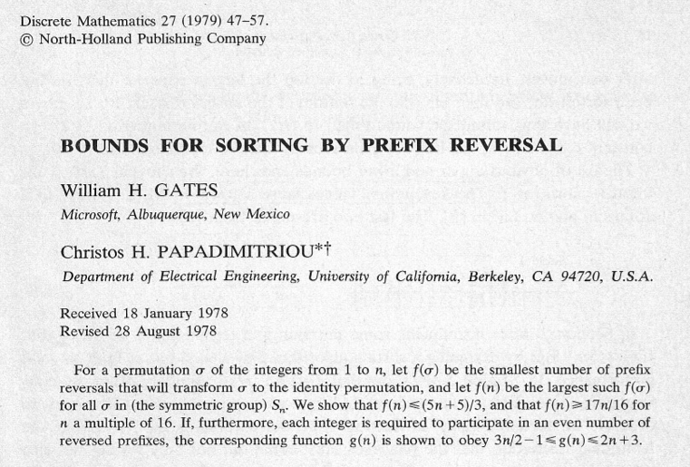

Slide 13
Example Induction Proof
Let’s prove:
(for r ≠ 1)

Slide 14
Example Induction Proof
Statements in magenta form a
template for inductive proofs:
Proof: (by induction on n)
The induction hypothesis, P(n), is:
(for r ≠ 1)

Slide 15
Example Induction Proof
Base Case (n = 0):
1
OK!

Slide 16
Example Induction Proof
Inductive Step: Assume P(n) for some n ≥ 0 and prove P(n+1):

Slide 17
Example Induction Proof
Now from induction
hypothesis P(n) we have
so add r^{n+1} to both sides

Slide 18
Example Induction Proof
adding r^{n+1} to both sides,
This proves
P(n+1)
completing the
proof by induction.

Slide 19
an aside: ellipsis
Means you
should see a pattern:
“☹” is an ellipsis.
Can lead to confusion (n = 0?)
Sum notation more precise

Slide 20
FINIS

